Slide 1
SyriaTel Customer Churn Analysis
Predicting Customer Churn to Reduce Revenue Loss

Slide 2
Overview
SyriaTel is losing money every time a customer leaves
This analysis predicts which customers are likely to churn
Early identification allows the retention team to intervine

Slide 3
The Business Problem
Customer churn = lost revenue
Key question: Are there predictable patterns in customer behavior?

Slide 4
About the Data
There are 3,333 customer records
21 features including call usage, charges and plans
Only 14.5% of customers churned – imbalanced dataset

Slide 5
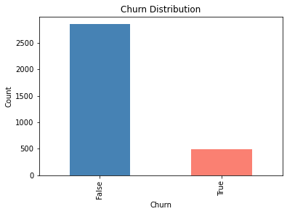
Churn Distribution
Only 14.5% of customers churned (483 out of 3,333) — early identification is key to reducing revenue loss

Slide 6
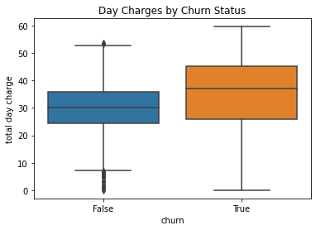
What Drives Churn ?
Customers who churned paid significantly higher day charges — targeting these customers early can prevent revenue loss

Slide 7
Our Approach
Built 3 models iteratively
Model 1: Logistic Regression(baseline)
Model 2: Decision Tree
Model 3 : Tuned Decision Tree (final model)

Slide 8
How Well Does It Work?
Our model correctly identifies 94% of cases
When it flags a churner, it is right 88% of the time
Model performs consistently on both training and test data

Slide 9
Recommendations
Deploy the model to flag at-risk customers automatically
Focus retention efforts on high day charge customers
Offer discounts or upgrades to flagged customers

Slide 10
Next Steps
Try Random Forest for better performance
Address class imbalance using SMOTE
Monitor model performance over time

Slide 11
Thank you

